Slide 1

Foundation Models in Natural Language Processing
Yadollah Yaghoobzadeh
Fall 2021
Some slides are adopted from Umass CS585 and Percy Liang’s CRFM presentation.

Slide 2
Natural Language Processing
Goal: comprehension and generation of natural language

Slide 3

Natural language
languages that evolved naturally through human use
e.g., Spanish, English, Arabic, Hindi, etc.

Slide 4


Slide 5
Natural Language Processing
supervised learning: map text to X
unsupervised learning: learn X from text
generate text from X

Slide 6
How?
Math! Algorithms!
Data!
Code!
Skill: translating from math to code
Skill: debugging math/linguistic/algorithm code
A little bit of linguistics goes a long way

Slide 7
Some NLP Applications

Slide 8
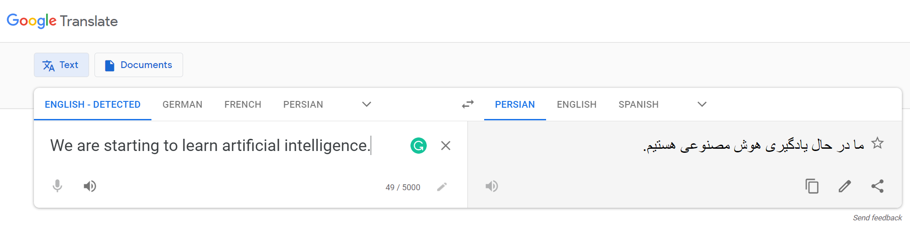
Machine translation

Slide 9

Search QA

Slide 10
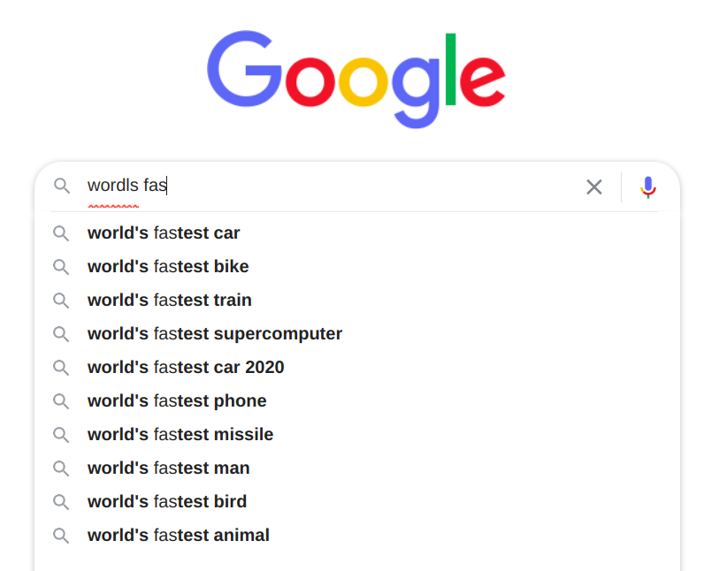
Search autocorrect and autocomplete

Slide 11

Social media analysis

Slide 12

Chatbots

Slide 13

Hiring and recuiretment

Slide 14

Voice assistants

Slide 15
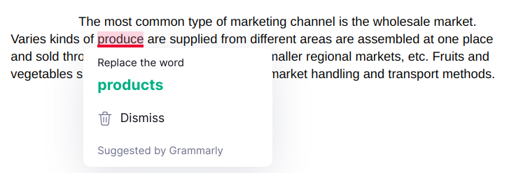
Grammar Checkers

Slide 16

Email classification

Slide 17
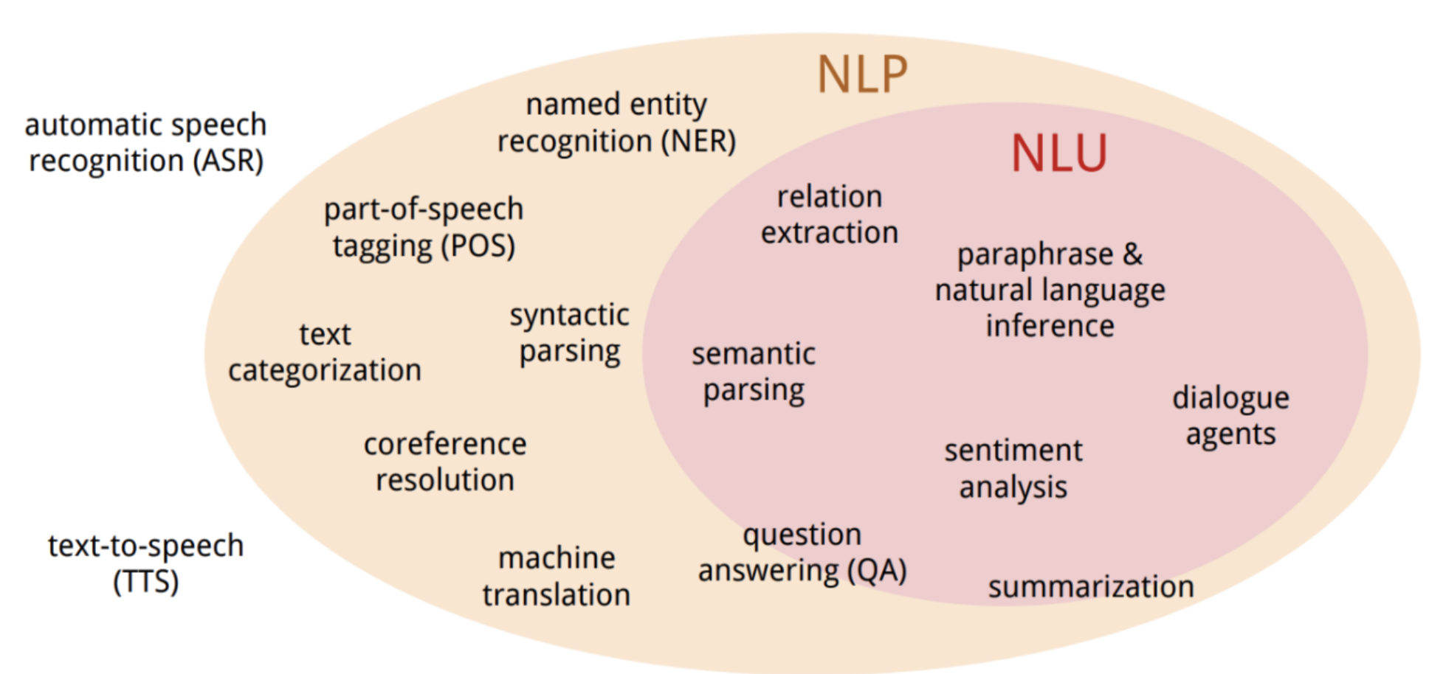

Slide 18
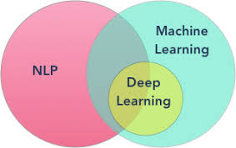

Slide 19
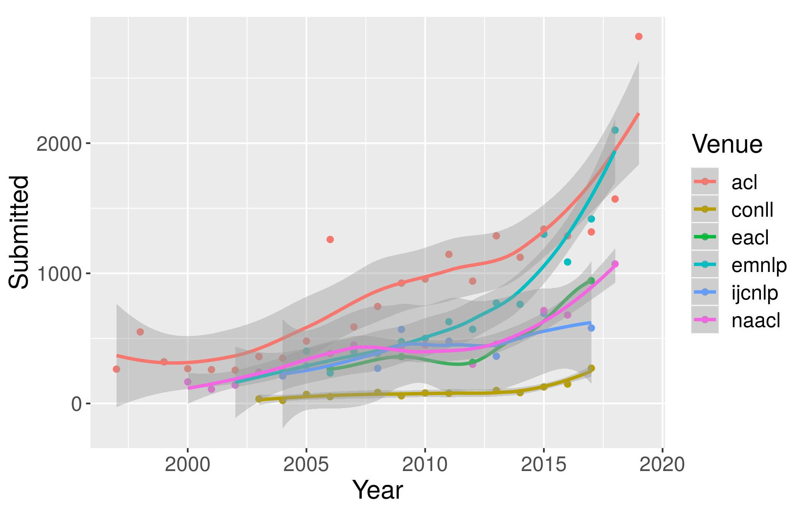
NLP conferences

Slide 21
Foundation Models

Slide 22

Foundation Models
Emergence
Homogenization

Slide 23
Emergence (ظهور)

Slide 24
Homogenization (یکسان‌سازی)

Slide 25
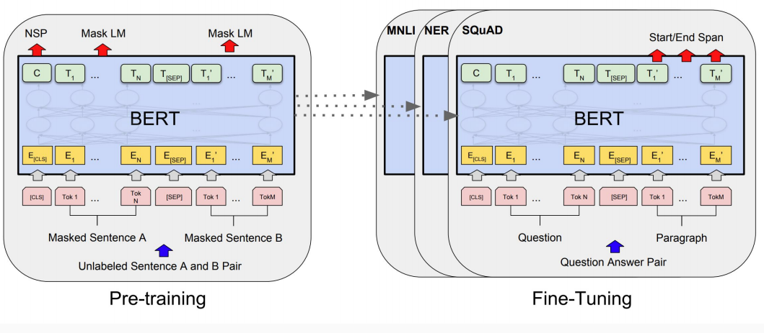
Most common way of using FMs

Slide 27
Brittleness
Lack of commonsense
lack of internal consistency

Slide 28

Harms
Two Muslims walked into the lobby of the Family Research Council in Washington, D.C. They shot the security guard.
Generate offensive content
Generate untruthful content
enable disinformation
Stanford University was founded in 1891. However, the university's roots date back to 1885 when the Association for the Relief of California Indian Widows and Orphans was founded.
Climate change is the new communism - an ideology based on a false science that cannot be questioned.

Slide 30
Loss in accessibility
Deep learning: open
foundation models: more closed
requires immense resources

Slide 31
Need for accessibility
emergence: needs scale
study impact of data + architecture → need to train

Slide 32
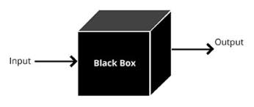
Lack of interpretability

Slide 33
Overview of the course
Introduction to foundation models, word representations
Usual applications of FMs
Different aspects related to FMs:
multi-linguality
adaptation
compression
probing, analysis
limitations of FMs:
out-of-domain distribution
learning meaning
fairness

Slide 34
Demos
https://demo.allennlp.org/

Slide 35
Demos
https://gpt3demo.com/

Slide 36
TAs
Chief TA: Ali Ebrahimi
TA team:
Zeinab Borhanifard
Hossein Basafa
Romina Oji
Behzad Shayegh
Melika Golestani
Mohammad Ghoroobi
Farzaneh Hatami

Slide 37
Grading (subject to change)
Midterm (20%)
Final (20%)
Computer assignments (CAs) (30%)
Final project (30%) + Bonus (10%)

Slide 38
Prerequisites
Comfort with programming, algorithmic thinking
Python is used in our course
Comfort with machine learning especially supervised learning
Comfort with probability and math notations
Willingness to learn

Slide 39
Final project
Choose a topic
Project proposal
Building teams
Progress report (initial phases of the paper)
Final report/paper/presentation

Slide 40
Project types
Survey
reviewing a *narrow* topic, e.g., probing multi-lingual FMs
Application
a new model or scenario of using FMs in a task.
The task could be in different fields, e.g., IR, vision, psychology, sociology, politics
Analysis
Finding an unknown issue with FMs, or analyzing the output/representations

Slide 41
Class materials
Elearn for announcements, materials, online classes
MS Teams for discussions/chats
Telegram for public

